Slide 1

Secure Home Surveillance System Project
Hayden Phifer

Slide 2
About Me
6-year journey to bachelor’s degree
Changed majors 5 times
When we realized getting a degree in 4 years wasn’t realistic, my father told me to find a way to pay for college myself
Enlisted in the Army National Guard
Needed to find way to support myself and pay for college
Returned after basic training and chose the fastest degree to finish: Aviation Management
Not my first choice, but it would get me out of college ASAP
Reality check around graduation time
Aviation career options did not fit my interests or passions, would have hated working in the industry
Immediate pivot to graduate school to realign into IT
Graduate Certificate in Cybersecurity Management completed in May
Master of Science in Information Management finishing in December
Continued service and upskilling
Renewed Guard contract with path to retrain as Cyber Operations Specialist to further align my experience with IT
Spent summer studying for and passing CompTIA’s Security+ exam

Slide 3

Brief Overview
Designed and Implemented a secure, local-only surveillance system
Performs continuous video recording and automated backup/retention with no cloud dependence
Remote viewing is only possible through encrypted VPN access, not through the internet or commercial vendor servers
The system is designed to recover from failures automatically

Slide 4
Why I Chose This Project
I wanted a surveillance system that keeps footage local-only and privately controlled
Most commercial camera systems require
Paid subscriptions
Mandatory cloud storage
No user-friendly customization or local retention options
Major vendors have had massive privacy failures, proving that cloud ≠ secure
Ring doorbell illegally surveilled customers
Verkada failed to secure cloud video storage
Amazon keeps recordings forever, despite deletion requests
If I want privacy, I shouldn’t have to give my data to someone else

Slide 5

Project Goals
Private networked camera system with no internet access
Store minimum of 24hrs of footage on 10+ year old PC I had in storage
Remotely view the live footage, but not the stored footage
Spend as LITTLE money as possible

Slide 6

Hardware

Slide 7

Camera
What I looked for in my camera
Open Network Video Interface Forum and Real Time Streaming Protocol
Able to function entirely offline
No mandatory subscriptions or cloud dependence
Locally controlled
Low cost
Reolink E1 Pro

Slide 8

Old Personal Computer
Alienware X51 R3 from 2015
CPU: i7-7600
RAM: 16GB DDR4 @ 2133MHz
GPU: NVIDIA GTX 745
Old, but works for basic hardware encoding options
OS: Windows 10 Home → Windows 10 IOT Edition
Had to change editions with the sunset of official windows 10 support and security updates
Storage pool: 2TB hybrid drive
12-14.5 days of maximum continuous recording
Power: small UPS with approximately 10 minutes of battery backup
Security: Bitlocker encrypted drive with maximum password length

Slide 9

Router
What I looked for in a router
Can create isolated Virtual Local Area Networks
Physically and logically separate camera system from rest of home network
Supports WireGuard VPN
Faster, modern, more secure VPN with lowest overhead compared to older OpenVPN/IPSec standards
Complete control over my own network traffic and enterprise-level customization options
Stop the camera from being able to stream or be accessed from outside the network
See and analyze logs to ensure that nothing does leave the network
Can also handle the rest of my household wifi traffic
This was more than just a purchase I made for my project, the router would have to be able to support my entire network
Ubiquiti’s Unifi Dream Router 7

Slide 10

Software

Slide 11
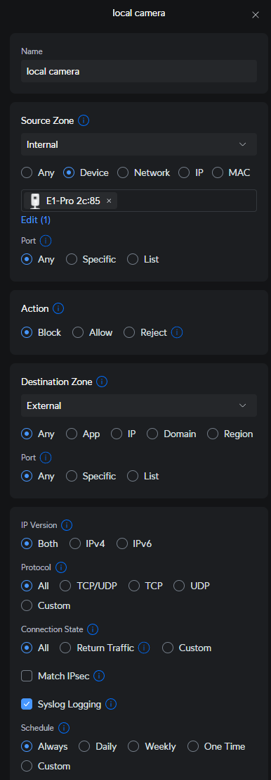
Router
Purpose
Network Segmentation: Put camera on isolated VLAN with nothing except PC running OBS
Firewall Policy: Restrict camera access to internet and other VLANs
DHCP/DNS Control: Reserved static lease for camera so RTSP URL and OBS source never changed
WireGuard VPN: Created a WireGuard profile for my phone to reach the LAN privately and securiely
Key Settings
Network: Separate VLAN for home surveillance network, DHCP reservation
Firewall: Blocking all connections from camera to WAN (except to ntp server), block all connections from surveillance network to other networks and vise versa, block all access to camera from WAN.

Slide 12

Open Broadcaster Software (OBS) Studio
Overview
Free, open-source recorder and streamer
Can ingest RTSP feeds, screen recordings, media files, web browsers, audio inputs, and more
Allows plugins and has the option to stream, edit, and record source content
Why It Was Chosen
Easy to use with a small number of camera
Familiarity with the program from past interactions, and user-friendly interface
No overly complex setup and use like fuller NVR suites
Plenty of options with how to record and encode video
How It Was Used
Camera RTSP stream was added as a media source
Records as .mkv files so that any interruptions would not affect the entire video (unlike .mp4)
Open-source plugin added to ensure that stream refreshes periodically to prevent freezing

Slide 13

Cobian Reflector
At A Glance
A backup scheduling tool that can run as a service
Supports per-task encryption
Retention by number of full copies rather than by age.
Supports pre or post task events
Has the ability to not touch in-progress/in-use files
Why It Was Chosen
Could automate encryption and backup of OBS recordings
Could run in the background as a service
Can prune old data sets and prevent casual users from accessing files
Configuration and Use
Service Mode: Installed and run as a Windows Service for reliability without requiring logon
Target and Security: Wrote to a dedicated vault folder on a fixed-letter drive with BitLocker enabled
Task Options: No compression, AES-128 bit encryption, Volume Shadow Copy disabled, file named as date/time
Schedule: Short timer corresponding to OBS segments to ensure that videos are immediately moved and encrypted
Retention: Keeps 7 days worth of footage (168 one-hour OBS segments), deletes source after successful backup

Slide 14
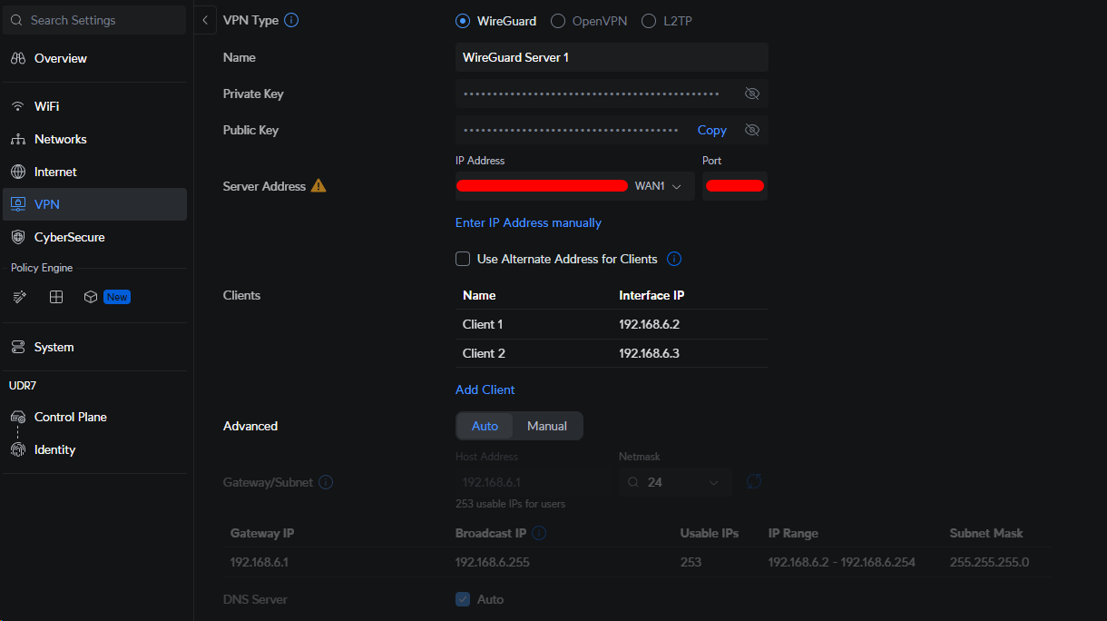
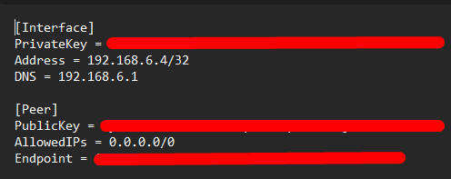
Wireguard VPN
Overview
Modern, fast, secure, low-overhead VPN with smaller attack surface and simple onboarding
Why It Was Selected
Runs natively on my Unifi router
Secure access to my network without exposing it to the public
Performs better and is easier to setup on mobile than OpenVPN or IPSec
Use and Configuration

Slide 15

The Rejects Pile

Slide 16
Software DVRs
Agent DVR
Shinobi
What is Agent DVR?
Windows-centric NVR with browser UI for live view and playback
Works with most IP cameras via RTSP or ONVIF
Why I Rejected it
Struggled to connect it to the camera via RTSP
Couldn’t stream without paying
If I paid, stream wouldn’t be secure and would be viewable to anyone who probed my network
What is Shinobi?
Open-source NVR designed for Linux
Works with most IP cameras via RTSP and ONVIF
Can only be installed on Windows via Docker
Why I Rejected it?
Complex setup
Lack of a true “set it and forget it” workflow
Clunky UI and issues connecting the camera
Required other software to run
Lack of secure streaming option for phone

Slide 17
Routers
Spectrum
Wave 2-SAC2V1A
ASUS RT-AX1800S
ASUS RT-BE58U
Free ISP-Provided Router
No customization options
Locked to single VLAN
Wifi 5 Only
Could not choose between 2.4GHz and 5GHz networks
Cheap Router
No way to block devices from accessing internet
Very poor logs
Wifi 6
Locked to a singular VLAN
No VPN
Medium cost Router
Still no way to block devices from accessing internet
Still very lucklaster logs
Wifi 7
Allowed creation of multiple VLANs, but no individual customization or control options
Had built-in VPN options

Slide 18
Secure Streaming Software
Jami
OBS Studio + External Site
What is Jami?
Free, open-source, peer-to-peer messenger for text, voice, and video
End-to-end encryption
No centralized server
Why Did I Initially Choose It?
Fits privacy and security model: E2EE, no cloud storage, easy to setup, comes with app for both PC and iPhone
Why Did I Reject It?
It was not a RTSP client, usage depended on screen sharing from PC
My old PC couldn’t handle doing recording with OBS, viewing with VLC media player, video calling with Jami, and encrypting/backups all at the same time
Didn’t enjoy using the app
OBS Studio
Already using it to record
Could also use it to stream with little additional overhead
Stream to My Own Domain
I already have my own domain, but no hardware
Could buy/subscribe to cloud computing, but would still be entrusting my data to a third party
Public exposure of the stream and of my home network if misconfigured
Stream to YouTube
Could stream as either unlisted (no security, but I’m the only person with the link) or private (only people signed into google accounts that I authorize could view)
Has DVR so I could pause, rewind, and fast forward through livestream for up to 12 hours of footage
Stores my video on YouTube’s servers
Is against YouTube’s terms of service

Slide 19

Struggles

Slide 20
OBS Issues
Long-running RTSP sessions would randomly stall; OBS kept last good frame on screen instead of auto-recovering
Tried to force reliable RTSP over TCP with longer timeouts, but that didn’t fix it
Ffmpeg option: rtsp_transport=tcp rtsp_flags=prefer_tcp stimeout=20000000 rw_timeout=20000000
Reduced buffering, set reset delay, allowed unlimited retries, changed rendering and encoding methods, etc. - but none of it worked
Finally installed an OBS plugin that allowed me to refresh the media source every 5 minutes to fix any frozen frame issues
So many settings and customization options, it took weeks to test everything out and determine the optimal settings for my setup
How many frames per second
What resolution
What type of media source to use
Researching all the different encoder settings
What filetype to record in

Slide 21
Selection Issues
Camera
Had to sift through hundreds of cheap cameras on amazon and decide on the best one based on the limited budget I gave myself
Router
Took 4 routers and lots of research before I finally discovered a router that actually did everything I needed
Companies frequently mislead or withheld information about router capabilities and abilities
NVR Software
Sifting through multiple different free and/or open-sourced options took a long time, and a lot of trial and error setting up
Got tired of trying to use all-in-one suites so I broke it up into the 3 functions I needed: recording, encrypted storage, and secure streaming
Remote Viewing Method
Thousands of apps that could have been used, hundreds with E2EE video calls/feeds, very few that could work unattended, even fewer that had methods of ensuring that only intended recipients could see camera feed
Wanted to use my own domain, but ultimately ran into an issue with equipment cost, the time it would take to setup my own equipment for this function, or trusting someone else to host everything

Slide 22
Secure Storage Issues
Cobian Reflector
Kept deleting files that were in-use until I did more research
Takes a lot of processing power to encrypt and store videos
Hundreds of folders created for backups
Storage
Had to adjust video length from 24 hours (7 neatly categorized videos) to hour long videos for Cobian Reflector
Anyone can theoretically walk in and view/delete the video currently in progress
Trade off between .mkv and .mp4 files → resiliency vs security
Encryption
No way to encrypt the video recordings in real time

Slide 23
Cost Issues
Camera
Cheaper camera will overheat after a few days of continuous use
Wi-Fi cuts out briefly (long enough to interrupt OBS recording)
LAN was only possible AFTER setting camera up in the cloud
NVR
Full-service NVRs that could do everything I wanted (Blue Iris, ZoneMinder, etc) were no longer an option
Had to use multiple different programs instead of an all-in-one solution
Storage
Had to use free Cobian Reflector instead of a paid backup/encryption solution
Had to configure settings in Cobian Reflector, OBS, and Windows to make it work
Remote Viewing
Hard to find free options that didn’t want to view/use my video or that wouldn’t be illegal to use
Many VPN services require payment

Slide 24

Lessons Learned
“Trust but verify” does not apply in the realm of privacy
Network logs show camera tried to send data to hundreds of IPs
Don’t always choose the first option
I’ve learned to keep researching to find the best option instead of the easiest option
Low budgets cost time
A higher budget would have allowed me to complete this project within a week, but instead it took months to research how to bring everything together to perform the task that a single paid software could have done
It’s more fun to learn by doing than learn by researching, but a lot less informative
While it was fun to play around with different software and settings at first, I found that without reading the product documentation or understanding the concepts behind it, that I struggled to make everything come together because I lacked key pieces of information

Slide 25

Product Demonstration

Slide 26
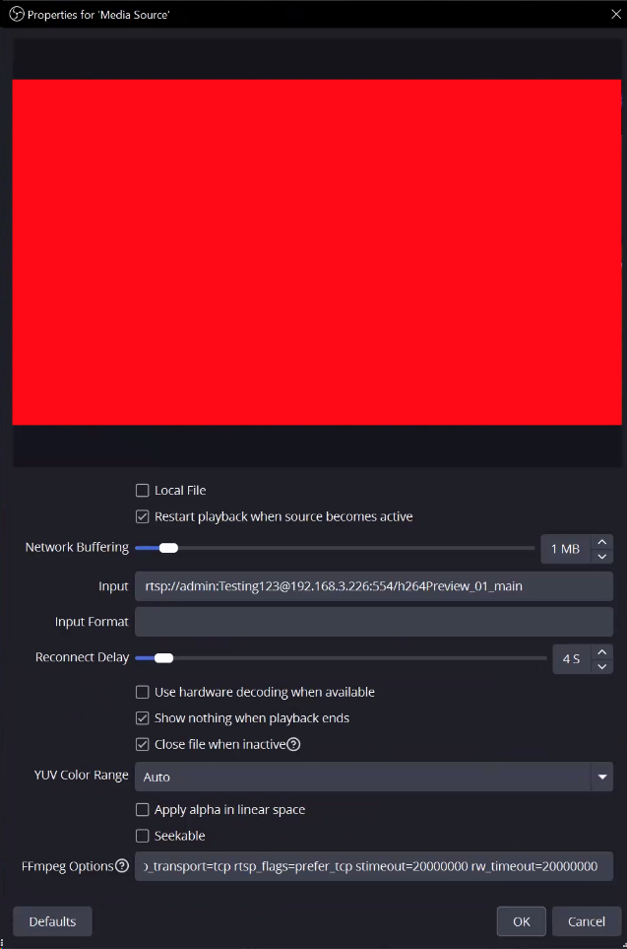
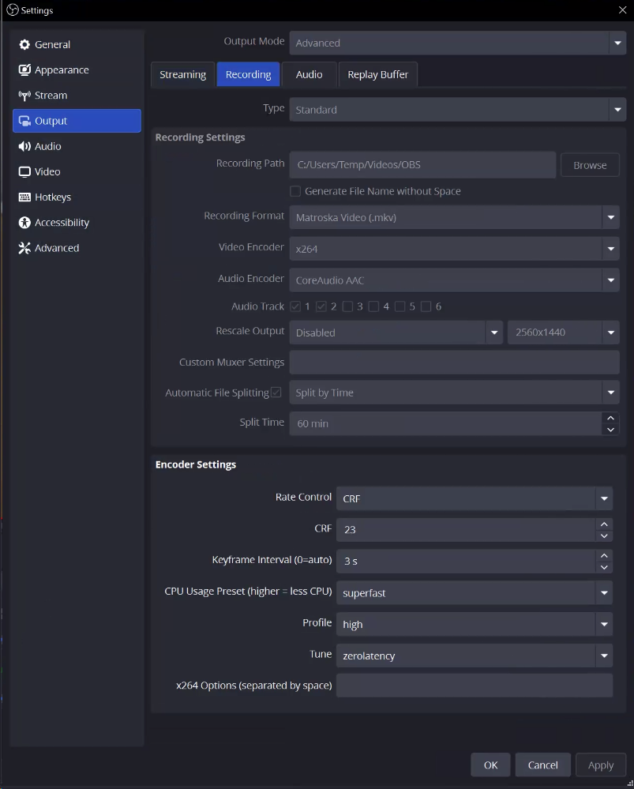
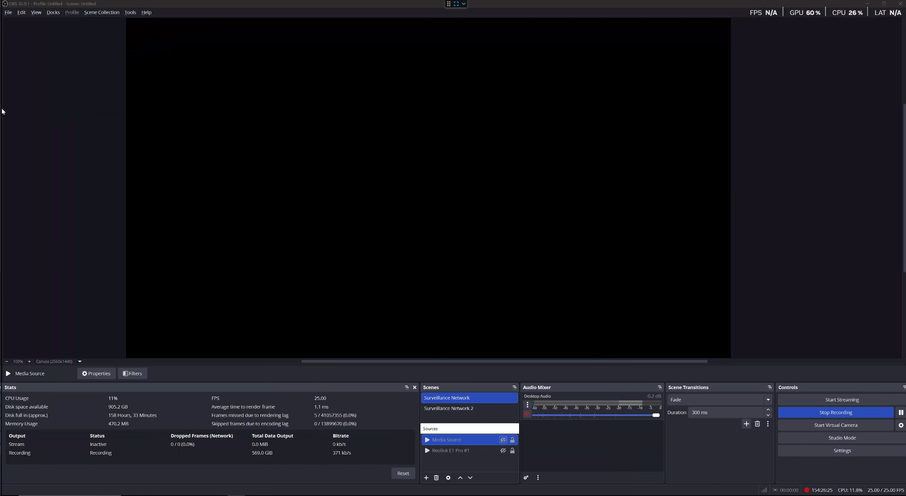
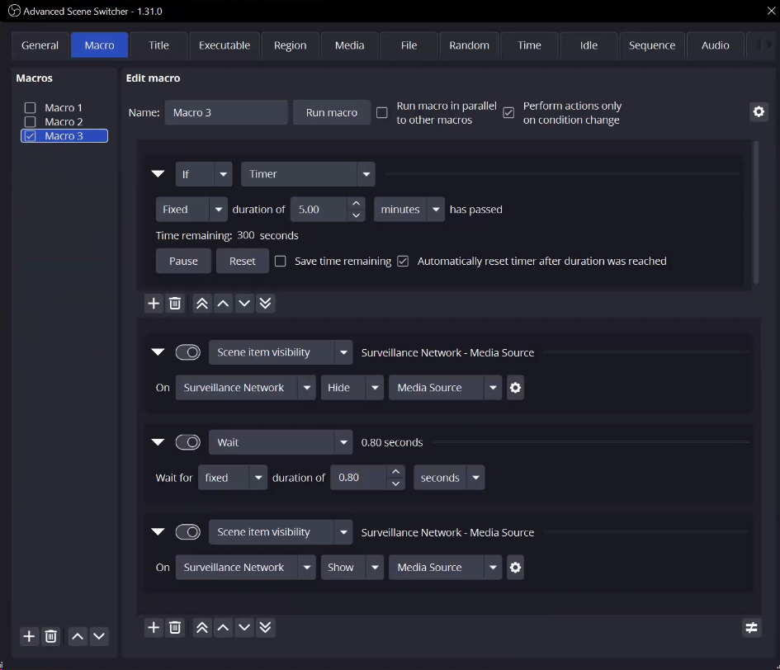
OBS Software

Slide 27
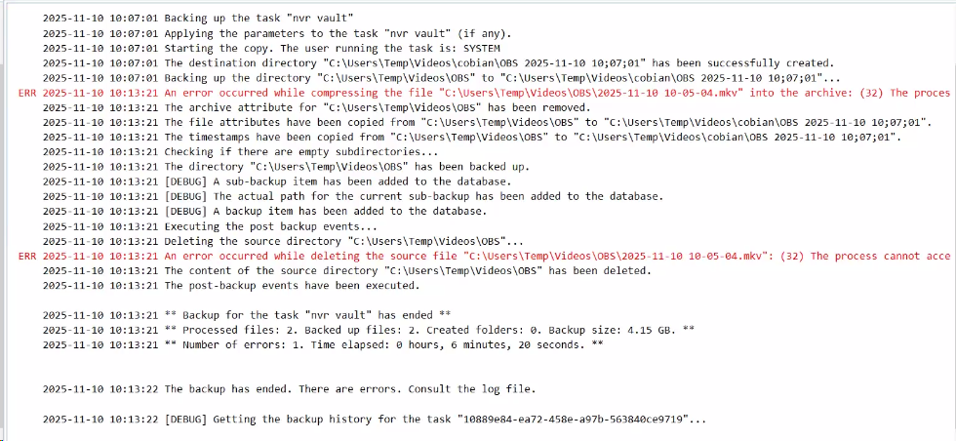
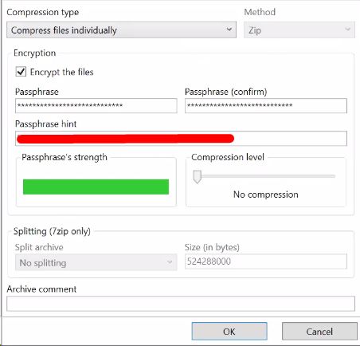
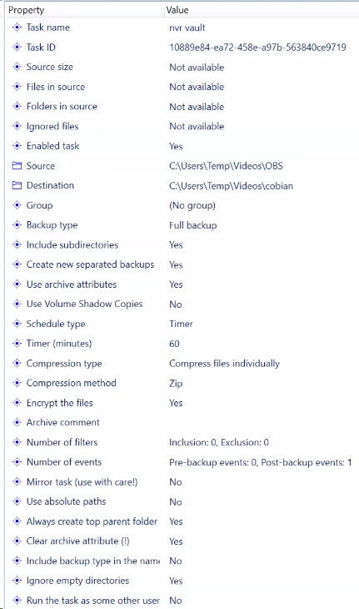
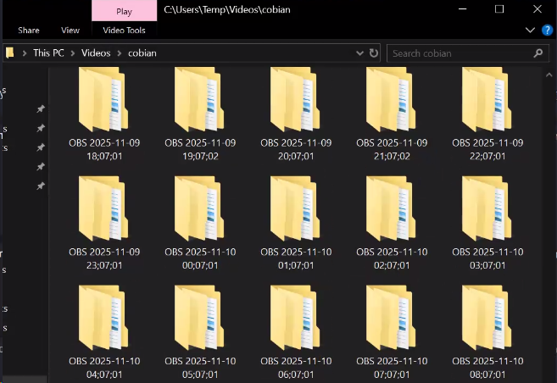
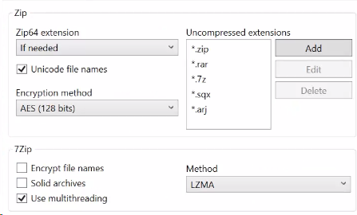
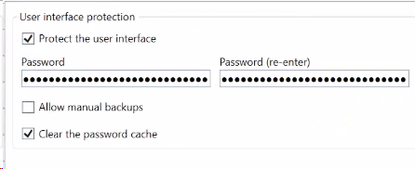
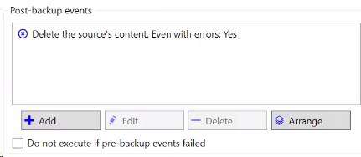
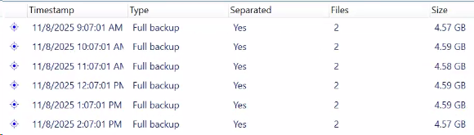
Cobian Reflector

Slide 28
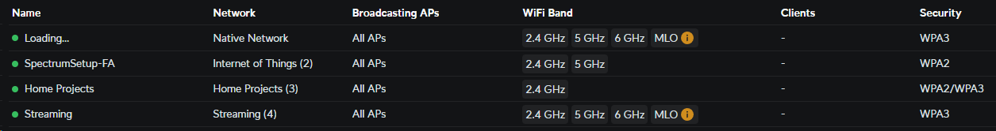
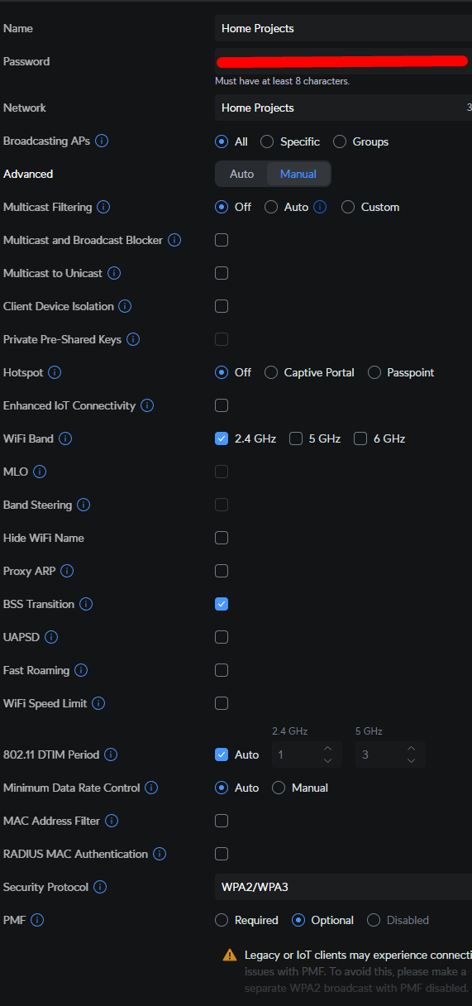
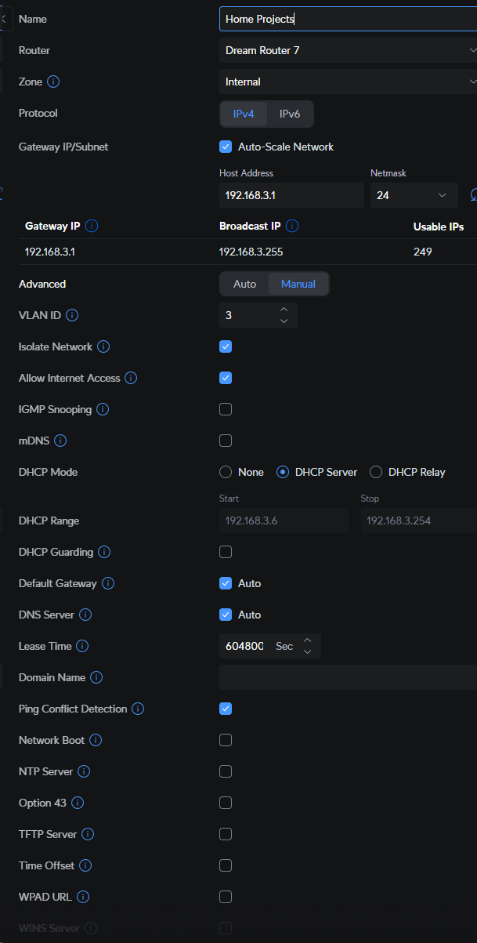
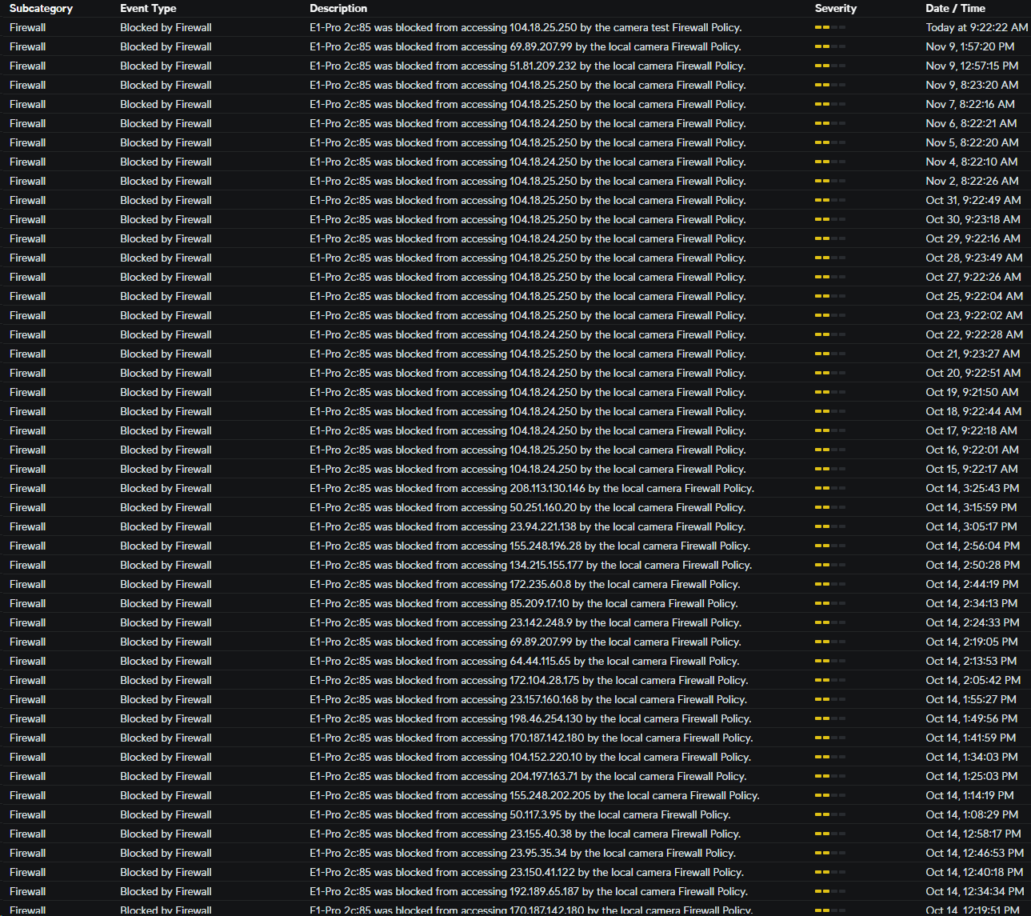
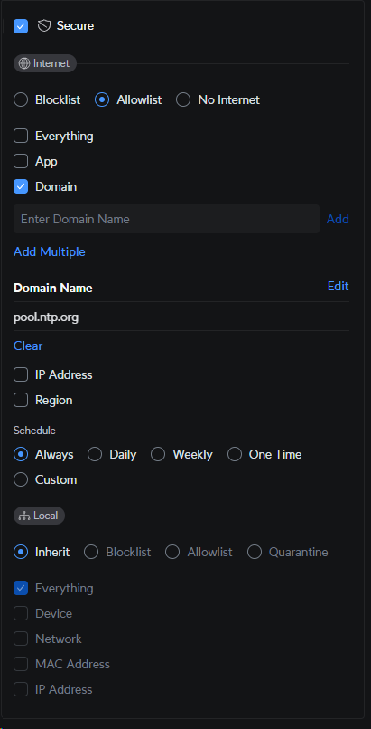
Unifi Router Settings

Slide 29
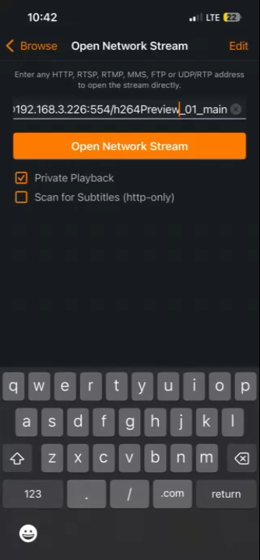
View from Phone

Slide 30
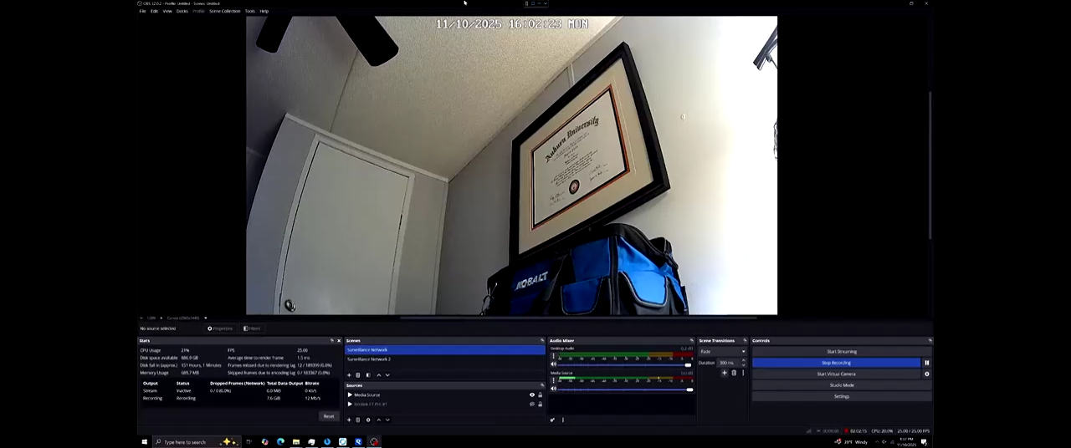

Slide 31

Any Questions?

